Slide 1
R5.7 Measurements
Change Summary

Slide 2
Content for R5.7 MHB Point Release
Added clarification in 3.5.2 k) concerning resubmission of erroneous pre-certification data
Clarified the treatment of individual FRU types in 4.2.5 Product Exclusions
Corrected the wording in Section 7.1 FR to match the change made in the R5.6 Point Release to exclude products in their retirement phase from data reporting
Replaced Section 8.2 SPR with new Section 8.2 eSPR
Product and Service Category Tables update

Slide 3
MHB / PCT 5.7 Release Milestones
eSPR addition and SPR removal - Approved 8/21/2019
Final Delivery of Any Additional Content 12/31/2019
Develop MHB 5.7 Point Release (PR) & 5.7 PCT Draft 1/16/2020
Issue Draft to IGQ ahead of February Meeting 2/04/2020
Approval for TIA-BPC Review of PR & PCT 2/11/2020
Submit PR & PCT for TIA QuEST Forum Comment Review 2/20/2020
TIA QuEST Forum PR & PCT Comment Review Ends 3/06/2020
TIA QuEST Forum Comments Resolved 3/18/2020
Create Scrub Sub-Team 3/31/2020
Vote by IGQ to Initiate the Vote for TIA QuEST Forum 4/15/2020
Implement Any Corrections for PR & PCT 4/22/2020
Vote by TIA-BPC to Approve PR & PCT for Release Ends 4/29/2020
Submit PR & PCT for Publishing 4/29/2020
Publish the PR & PCT 5/01/2020
Issue the PR & PCT Alert 5/04/2020
Effective Date of PR & PCT 6/20/2020
Mandatory Adoption of PR & PCT Dec 2020 Data

Slide 4
Revision Process

Slide 5
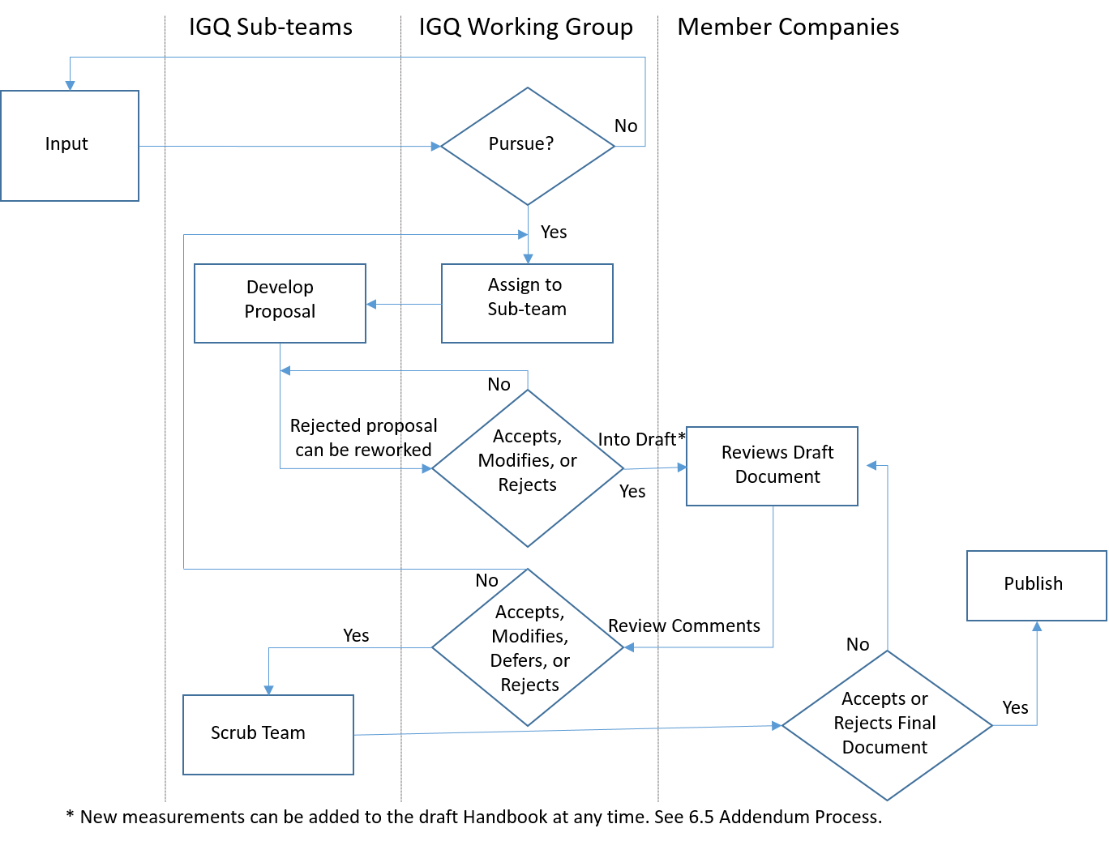
Handbook Production Process BPCP-031
Member Companies &
TL 9000 Users
Solicited
Web
Training
Questions
SMEs
Standing sub-teams
Initiatives/Streams
Not all may be used
for a point release

Slide 6
Why are sub-teams important?
Sub-teams are where
new ideas are developed…
6

Slide 7
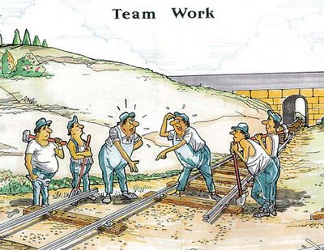
Contributing Sub-teams
Software Product Introduction
MHB R5.7
Product & Service Categories
7

Slide 8
Why Join a Sub-team?
Sub-teams:
Are where ideas are turned into reality
Are key to enhancing TL 9000 and the Forum
Meet “virtually” and don’t require travel
Great opportunities for sharing, learning, and networking
Provide leadership opportunities
Support professional growth
Support requirements for individual TL certification
Provide recognition
Thank-you to the many who participated in IGQ and Oversight Workgroups
and sub-teams to make TL 9000 Measurements Point Release 5.6 possible!
8

Slide 9
Changes

Slide 10
Section 3.5.2 k)
Added “This requirement also applies to the required three months of data submitted prior to certification.”
The reason for this change is to make it clear this requirement to re-submit erroneous data applies to the data submitted prior to certification. This is needed to verify checks built into the MRS do not find any issues with the corrected data.

Slide 11
Section 4.2.5 Product Exclusions
The last sentence was reworded to read -
  This exclusion does not apply to individual Field Replaceable Units which are part of a product in general availability that have been made obsolete by a later version unless those units are completely recalled from the field.
This added wording clarifies how this part of the requirement applies after the change to this section made in the R5.6 Point Release excluded to reporting of data for products in their retirement phase.

Slide 12
Section 7 Hardware Measurements
This wording in five places throughout this section has been revised to correctly reflect the change in the R5.6 Point Release to eliminate the reporting of data during a product’s retirement phase.
This eliminates the confusion raised by references to life cycle instead of general availability phase.

Slide 13
Section 8.2
Replaces the existing Software Problem Report Measurement (SPR) with a new Early Software Problem Report Measurement (eSPR). The new measure is similar to the old with the following changes:
  Only software problem reports within the first 12 months after the introduction of a major release are counted
  The normalization unit is the number of customers reporting problems with the release
The reasons for this change are;
  SPR is a straight subset of the NPR measure and does not provide much additional insight over and above NPR
  There is a strong need for a measure of early software quality

Slide 14
Section 8.2 eSPR Description
The early Software Problem Report (eSPR) measurement tracks the software problems that are found and reported by customers during early deployment, just after General Availability.
This measurement is used to evaluate the number of customer originated software problem reports that are indicative of the software quality of the product delivered during the early part of its operating life cycle.

Slide 15
Section 8.2 eSPR Rules
The counting rules in 5.1.4 b) apply in counting software problem reports for the eSPR measurement for all product categories, with the following clarifications:
Only software problem reports that are reported during the eSPR-Period shall be counted.
For the purposes of eSPR reporting, a software problem reported in a software release or a subsequent software update for that release, shall be attributable to the software release.
In cases where the software release or software update cannot be determined, the software problem report shall be attributed to the most recent software release.
Problem reports where the reported problem is suspected to be software related but cannot be reproduced during subsequent investigations shall be counted.
Duplicate software problem reports from the same customer for the same release or a subsequent software update shall be counted as a single problem report in the first month in which the problem is reported.
For the eSPR denominator, customers are only counted if they have reported at least 1 problem report for the release (within the eSPR-Period).

Slide 16
Section 8.2 eSPR Exclusions
The counting rule exclusions in 5.1.4 c) apply in counting software problem reports for the eSPR measurement for all product categories, with the following clarifications:
A problem report that is determined to be a hardware problem shall not be counted even if the design solution or workaround is implemented in software.
Problem reports due to faults in input data are excluded.
Software problem reports against a software release or associated software update that fall outside of the eSPR-Period for that software release are excluded.
If the organization cannot confirm the exact software release or software update to which the problem report is reported, but the organization knows that the defect in question has already been fixed in all software releases or software updates that were released in the previous 12 months, then the problem report in question is excluded.
A problem report reported after a software release is withdrawn or no longer supported is excluded.

Slide 17
Section 8.2 eSPR Data
Identifier | Definition
afactor | Number of calculation periods in a year
eSPs | Total number of customers that have reported at least one problem since the start of the software release’s eSPR-Period for each distinct software release(s) or associated software updates.
eSp1 | Total number of critical software problems reported for the month for software releases within their eSPR-Periods
eSp2 | Total number of major software problems reported for the month for software releases within their eSPR-Periods
eSp3 | Total number of minor software problems reported for the month for software releases within their eSPR-Periods

Slide 18
Section 8.2 eSPR Formulas
Identifier | Title | Formula
eSPR1 | Critical early software problem reports per customer-release | eSp1 x Afactor / eSPs
eSPR2 | Major software problem reports per customer-release | eSp2 x Afactor / eSPs
eSPR3 | Minor software problem reports per customer-release | eSp3 x Afactor / eSPs

Slide 19
Product and Service Category Tables
A new edition of the Product and Service Category Tables is being published in conjunction with the R5.7 Point Release. These changes included:
  Incorporating the change from SPR to eSPR within the tables
  Adding a new rule to the product category selection advice preceding Table A-1
    Organizations choosing a category in Families 1 through 6 or Family 8 cannot exclude Clause 8.3 in the Requirements Handbook in its entirety. Organizations without responsibility for design and development should look to the service categories in Family 7 for the appropriate category.
  Combining the four DSL categories into a single category
  Changing the manufacturing categories under 7.7 to include internal services
  Splitting 8.5.1 Optical Fiber (now Optical Fiber Material) into 8.5.1.1 Optical Fiber and 8.5.1.2 Optical Glass
  Changing one of the partial outage definitions in Table A-3 for seven categories
See the separate change history document for the Tables for full details

Slide 20
Point Release Certification
Rules

Slide 21
Point Release Certification Rules
Measurements Handbook
Primary concerns are to minimize impact on monthly PDR data and derive benefit from changes/additions as soon as feasible
  Set as short as practical
  Likely longer interval when adding a new measurement
  Shorter interval where a change is made to a measurement if the previous data cannot be easily converted
Must have a specific effectivity noting when first month data submissions are allowed and month when submissions are required
All point releases must be complied with at the compliance interval date
The interval should not be more than 6 months

Slide 22
Point Release Certification Rules
Requirements Handbook – No Modifications
New certifications
  Must use most current major release
  Voluntarily may certify to most current point releases
Existing certifications
  Point releases are not required for implementation until the next major release
  Organizations may be certified against a point release voluntarily
Point releases may be required by customers at any time after release

Slide 23
Point Release Certification Rules
Requirements Handbook – Modified requirements
New certifications
  Must use most current release
Existing certifications
  Must upgrade to the new Point release within the proscribed time frame

Slide 24
Point Release Publication and Pricing

Slide 25
Point Release Publication
Changed/new sections available as free download from tl9000.org (same as Product and Service Category Tables)
Incorporated in electronic versions for new sales
Previous release will remain available as long as certification to that release is still valid

